Slide 1
Forecasting Process
https://www.itl.nist.gov/div898/handbook/pmc/section4/pmc4.htm

Slide 2
Introduction to Time Series Analysis
Time series methods take into account possible internal structure in the data
Time series data often arise when monitoring industrial processes or tracking corporate business metrics.
Time series analysis accounts for the fact that data points taken over time may have an internal structure (such as autocorrelation, trend or seasonal variation) that should be accounted for.
See a brief overview of some of the more widely used techniques in the field of time series modeling and analysis.

Slide 3
Definition of Time Series: An ordered sequence of values of a variable at equally spaced time intervals. (Time series occur frequently when looking at industrial data) Applications- two fold: 1. Obtain an understanding of the underlying forces and structure that produced the observed data. 2. Fit a model and proceed to forecasting, monitoring or even feedback and feed forward control. Used in many applications such as: Economic Forecasting Sales Forecasting Budgetary Analysis Stock Market Analysis Yield Projections Process and Quality Control Inventory Studies Workload Projections Utility Studies Census Analysis and many, many more...
Introduction to Time Series Analysis

Slide 4
Moving Average or Smoothing Techniques
Smoothing a data, removes random variation and shows trends and cyclic components
( NB: Inherent in the collection of data taken over time is some form of random variation ).
Methods for reducing or canceling the effect due to random variation…. "smoothing".
Smoothing technique, when properly applied, reveals more clearly the underlying trend, seasonal and cyclic components.
There are two distinct groups of smoothing methods
Averaging Methods
Exponential Smoothing Methods

Slide 5
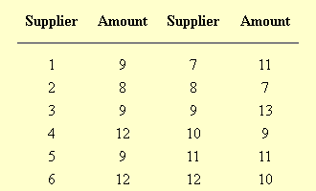
Smoothing methods(Averaging)
Taking averages is the simplest way to smooth data
Let us first investigate some averaging methods, such as the "simple" average of all past data.
A manager of a warehouse wants to know how much a typical supplier delivers (in 1000 dollar units).
A sample of 12 suppliers, at random, obtained the following results:
Mean of the data = 10.
The manager decides to use this as the estimate for expenditure of a typical supplier.
Is “mean” a good or bad estimate?

Slide 6
Mean Squared Error
Mean squared error is a way to judge how good a model is:
The "error" = (True amount spent - Estimated amount).
The "error squared" is the error above, squared.
The "SSE" is the sum of the squared errors.
The "MSE" is the mean of the squared errors.

Slide 7
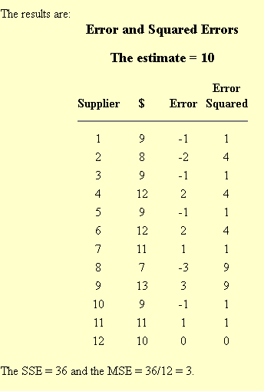
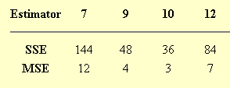
Mean Squared Error
So how good was the estimator (10) for the amount spent for each supplier?
Compare the estimate (10) with the following estimates: 7, 9, and 12. i.e., estimate that each supplier will spend $7, or $9 or $12.
Performing the same calculations we arrive at:
The estimator with the smallest MSE looks the best.
The estimator that minimizes the MSE for a set of random data is the mean.

Slide 8
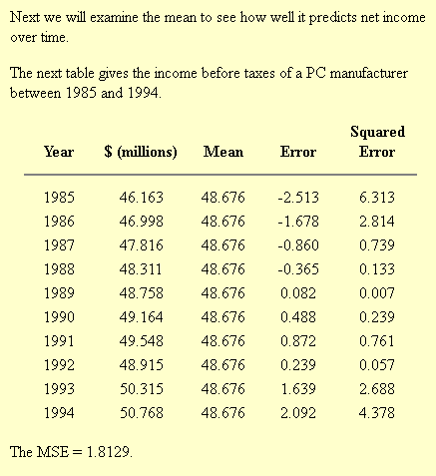
Mean Squared Error

Slide 9
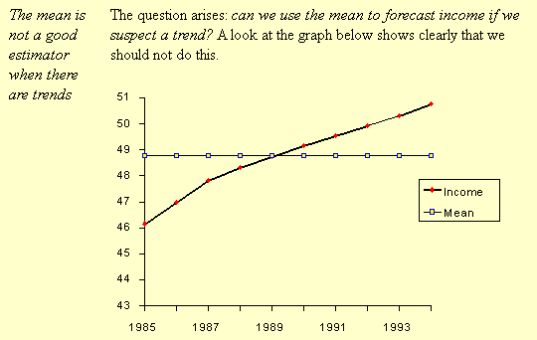
Mean Squared Error – For Forecasting

Slide 10
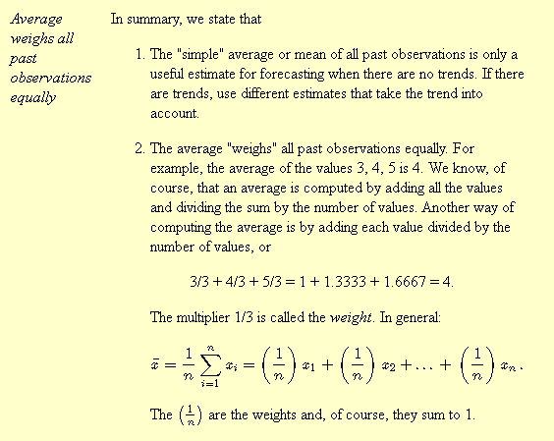
Mean – a good estimate when there are no trends

Slide 11
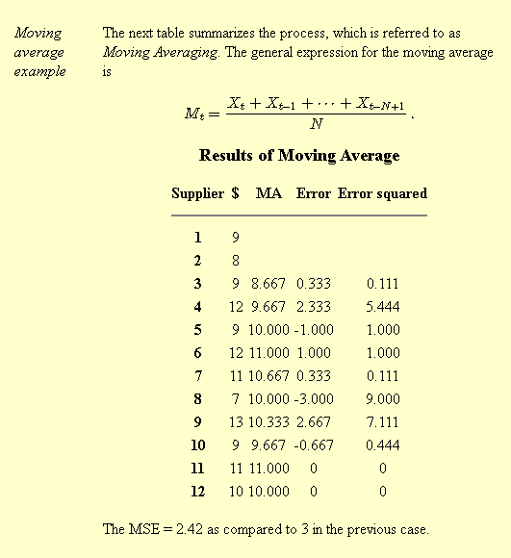
Moving Average

Slide 12
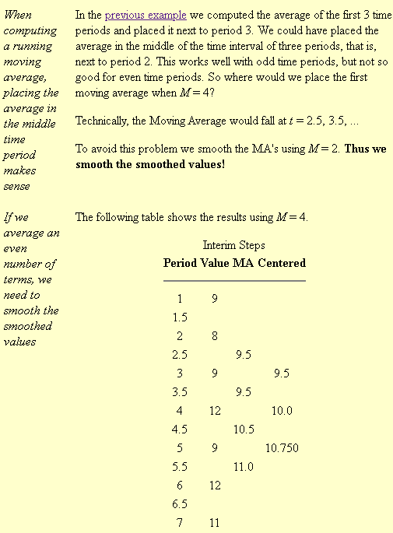
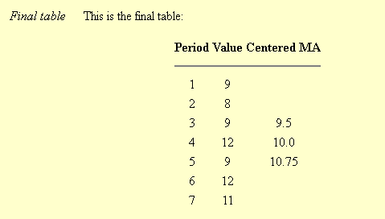
Centered MA

Slide 13
Double MA for a Linear Trend Process
Moving averages are still not able to handle significant trends when forecasting
Unfortunately,
neither the mean of all data nor MA of the most recent M values, when used as forecasts for the next period, are able to cope with a significant trend.
A variation on the MA procedure that often does a better job of handling trend… Double Moving Averages for a Linear Trend Process.
It calculates a 2nd MA from the original MA, using the same value for M.
As soon as both single and double moving averages are available, compute a slope and intercept, and then forecast one or more periods ahead.

Slide 14
Exponential Smoothing
Exponential smoothing weight past observations using exponentially decreasing weights.
NB: a popular scheme to produce a smoothed Time Series.
Whereas in Single MA the past observations are weighted equally
Versus
Exponential Smoothing assigns exponentially decreasing weights as the observation get older.
Recent observations are given relatively more weight in forecasting than the older observations.
In the case of MA, the weights assigned to the observations are the same and = 1/N.
In exponential smoothing, however, there are one or more smoothing parameters to be determined (or estimated) and these choices determine the weights assigned to the observations.
=> discuss Single, double and triple Exponential Smoothing.

Slide 15

Single Exponential Smoothing Exponential Weighted MA (EWMA)
Exponential smoothing weights past observations with exponentially decreasing weights to forecast future values
This smoothing scheme begins by setting S2 to y1
(where Si stands for smoothed observation and yi stands for the original observation)
The subscripts refer to the time periods, 1,2,…,n.
For the third period, S3=αy2+(1−α)S2; and so on.
There is no S1; the smoothed series starts with the smoothed version of the 2nd observation.
For any time period t, the smoothed value St is found by computing
. This is the basic equation of exponential smoothing and the constant or parameter α is called the smoothing constant

Slide 16
Exponential Weighted MA (EWMA) Initial EWMA
The first forecast is very important.
The initial EWMA plays an important role in computing all the subsequent EWMAs.
Setting S2 to y1 is one method of initialization.
Another way is to set it to the target of the process.
Another possibility would be to average the first 4 or 5 observations.
It can also be shown that the smaller the value of α, the more important is the selection of the initial EWMA.

Slide 17
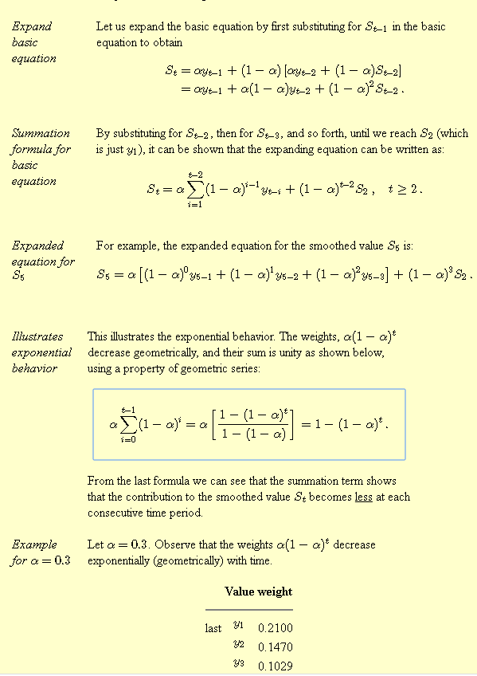
Why is it called Exponential??
(1 - a)^b as e^-ab.

Slide 18
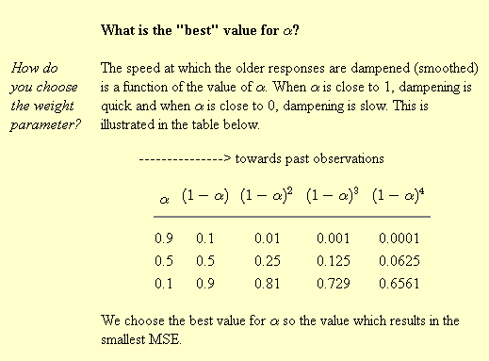
Single Exponential Smoothing Exponential Weighted MA (EWMA)

Slide 19
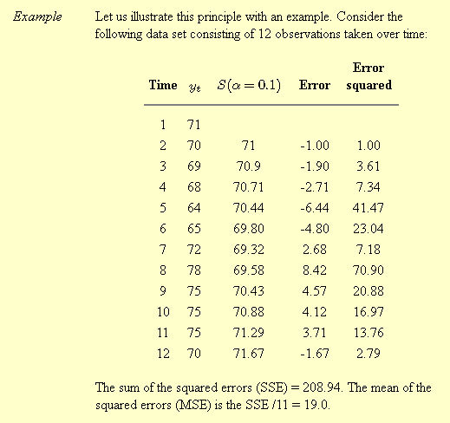
Single Exponential Smoothing Exponential Weighted MA (EWMA)

Slide 20
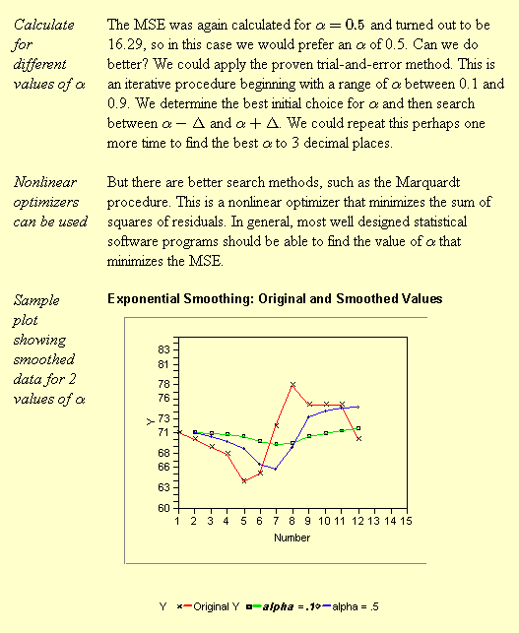

Slide 21
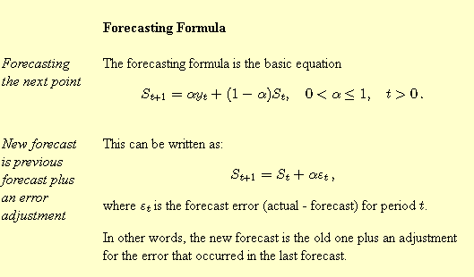
Forecasting

Slide 22
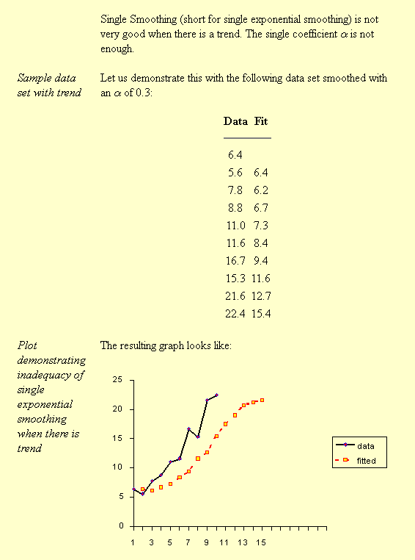
Single Exponential Smoothing with Trend

Slide 23
Summary
Exponential smoothing has proven to be a useful technique in many forecasting situations.
First suggested by C.C. Holt in 1957 and was meant to be used for non-seasonal time series showing no trend.
Holt later offered a procedure (1958) that does handle trends.
Winters(1965) generalized the method to include seasonality, hence the name "Holt-Winters Method".
The Holt-Winters Method has 3 updating equations, each with a constant that ranges 0 to 1.
The equations give more weight to recent observations and less weights to further in the past.
These weights are geometrically decreasing by a constant ratio.
Additional Reading – Double and Triple Exponential Smoothing.

Slide 24
Tutorial
1. Given the following 10 time series points (y1 to y10): 8,6,7,5,9,10,8,9,7,6.
Carry out smoothing employing Moving Average Method ( take M=3)and Exponential Weighted Moving Average, EWMA (alpha = 0.1).
Calculate the Mean Square Error(MSE) when (a) Moving Average with M =3, and (b) Exponential Weighted Moving Average (alpha = 0.1).
2. Consider the following time series points (y1 to y10): 8, 10, 12, 15, 18, 20, 24, 26, 29, 31.
Show that single smoothing (short for single exponential smoothing) is not suitable when a trend exists (such as in these data points). Plot the corresponding points to illustrate this aspect.

